Slide 1

Data Structures
Lecture 18: 2-3 Trees

Slide 2

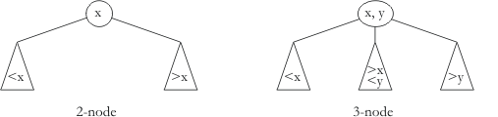
2-3 Trees
These are not binary search trees.
Because the nodes are not necessarily binary
7
3
11, 15
 They maintain all leaves at same depth
1
5
17, 19
   But number of children can vary
9
13
   2-3 tree: 2 or 3 children

Slide 3
Searching a 2-3 Trees
if r is null, return null (not in tree)
if r is a 2-node
if target equals data1, return data1
else if target < data1, search left subtree
else search right subtree
else // r is a 3-node
if target < data1, search left subtree
else if target = data1, return data1
else if target < data2 , search middle subtree
else if target = data2, return data 2
else search right subtree
7
3
11, 15
1
5
17, 19
9
13

Slide 4
Inserting an Item into a 2-3 Tree (1)
Inserting into a 2-Node Leaf
7, 15
7
(Inserting 15) We insert it directly, creating a new 3-node.
3, 5
3
11
17
17, 20
11, 15
11, 17
10, 11
11, 15, 17
11
Inserting into a 2-Item Leaf with a 2-Node Parent
(Inserting 17) The number will virtually be inserted into the 3 node at the bottom right
Let’s insert: 5, 10, and 20.

Slide 5
Inserting an Item into a 2-3 Tree (2)
Inserting into a 3-Node Leaf with a 3-Node Parent
7, 15
7, 11, 15
(Inserting 13) If we insert an item and all leaf nodes are full, one of the leaf nodes will need to be split.
3, 5
3
17, 20
10, 11
10, 11, 13
10, 13
This would result in two new 2-nodes with values 10 and 13, and 11 would propagate up to virtually inserted in the 3-node at the root.
Because the root is full, it would split into two new root node.

Slide 6
Inserting an Item into a 2-3 Tree (2)
Inserting into a 3-Node Leaf with a 3-Node Parent
7, 15
7, 11, 15
If we insert an item and all leaf nodes are full, one of the leaf nodes will need to be split.
3, 5
3
17, 20
10
10, 13
13
This would result in two new 2-nodes with values 10 and 13, and 11 would propagate up to virtually inserted in the 3-node at the root.
11
Because the root is full, it would split into two new root node.
7
15
3, 5
10
13
17, 20

Slide 7
Algorithm for Insertion into a 2-3 Tree
if r is null, return new 2-node with item as data
if item matches r.data1 or r.data2, return false
if r is a leaf
if r is a 2-node, expand to 3-node and return it
split into two 2-nodes and pass them back up
else
recursively insert into appropriate child tree
if new parent passed back up
if will be tree root, create and use new 2-node
else recursively insert parent in r
return true

Slide 8
Example on Inserting an Item into a 2-3 Tree
brown, jumps, quick
brown, jumps
brown
The
The, brow, quick
The, quick
“The quick brown fox jumps over the lazy dog”
quick
quick
over, the
over, quick, the
over, quick
fox, quick
fox, quick
The
fox
fox, jumps, quick
jumps
brown
quick
The
fox
dog, fox
over
the
lazy, over

Slide 9

Task
Show how the 2-3 tree below as you insert “apple”, “cat”, and “hat” in that order.
jumps
brown
quick
The
fox
dog, fox
over
the
lazy, over

Slide 10
Solution (1)
Adding “apple”
jumps
brown
quick
The, apple
fox
dog, fox
over
the
lazy, over

Slide 11
Solution (2)
Adding “cat” and hat
jumps
brown, dog
brown
quick
The, apple
cat
fox
fox, hat
dog, fox
cat, dog, fox
over
the
lazy, over

Slide 12
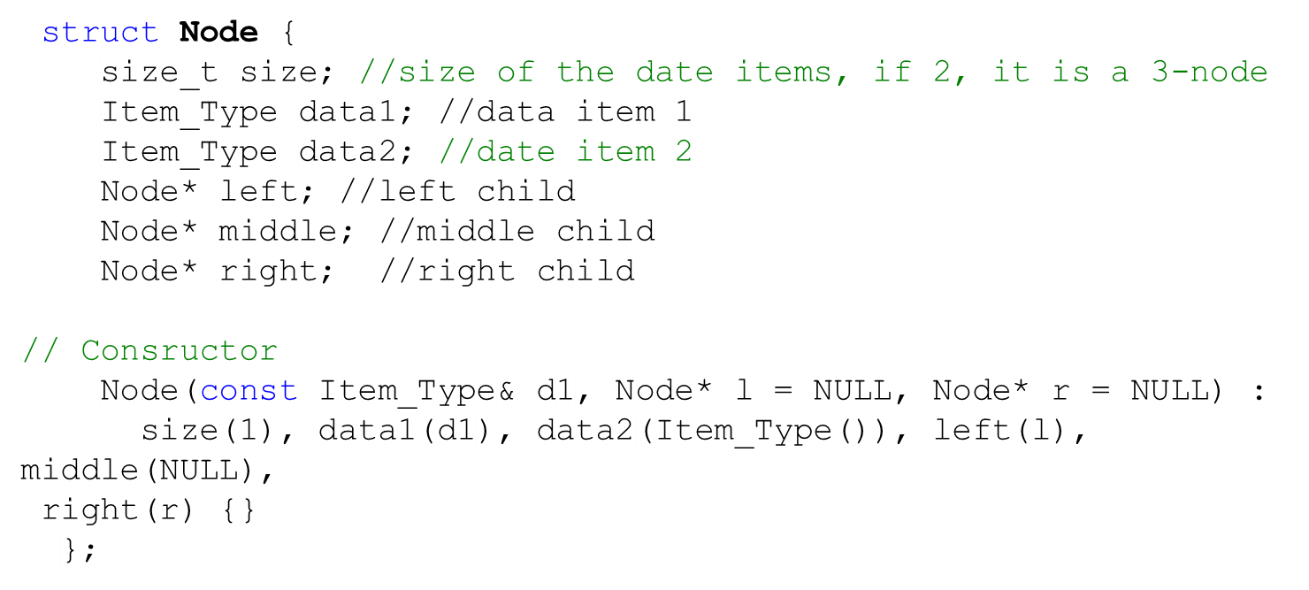
Task
Write a function that performs an inorder traversal of a 2-3 tree. Take a look at the definition of a 2-3 tree node:
4
2
9, 12
1
3
5, 6
10
13

Slide 13
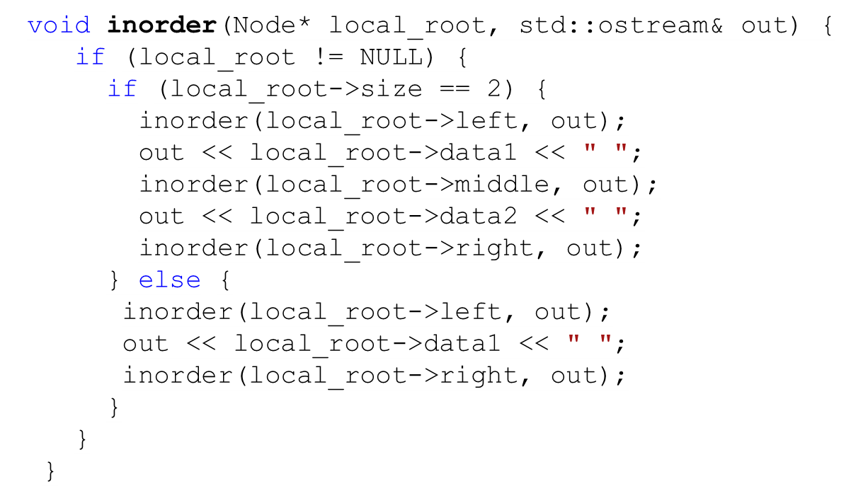
Solution
4
2
9, 12
1
3
5, 6
10
13

Slide 14
Task
Build a 2-3 tree from these numbers: 5, 18, 14, 16, 19, 25, 10

Slide 15
Solution
Build a 2-3 tree from these numbers: 5, 18, 14, 16, 19, 25, 10
14, 18
5, 10
16
19, 25

Slide 16
Removal from a 2-3 Tree (1)
We want to delete 17
7
3
11, 15
If we delete an item with a 2-item leaf node, we simply delete it
19
9
13
17, 19
1
5

Slide 17
Removal from a 2-3 Tree (2)
We want to delete 13
7
11, 17
11, __
3
11, 15
We need to find a replacement for 13 since gaps are not allowed.
19
9
13
17, 19
15
1
5
13
15, the inorder successor, is a good candidate.
But now we need a replacement for 15 itself, its inorder successor, 17, is a good candidate.

Slide 18
Removal from a 2-3 Tree (3)
We want to delete 11
7
15 , 17
__ , 17
17
3
11, 17
We need to find a replacement for 11. Its inorder successor, 15 is a good candidate.
9, 15
15
19
1
5
9
However, this will leave a gap, which is not allowed.
Hence, the solution is to make the 3-node (15, 17) a 2-node, by taking either 15 or 17 down.

Slide 19
Removal from a 2-3 Tree (3)
We want to delete 1
7
7, 17
17
3
9, 15
19
3, 5
We should maintain that all leaf nodes have the same depth. Hence, the other nodes have to be redistributed. We do that by propagating items from the sibling to the parent, and then rebalancing the tree.
9, 15
19
1
5

Slide 20
Removal from a 2-3 Tree (3)
We want to delete 1
7
7, 16, 18
16, 18
3, 5
3
We should maintain that all leaf nodes have the same depth. Hence, the other nodes have to be redistributed. We do that by propagating items from the sibling to the parent, and then rebalancing the tree.
9, 15
19
1
5
17
16
7
18
3, 5
9, 15
17
19

Slide 21
Task
Show the following tree after deleting each of the following values one at a time:
1, 5, 2, 9, 3
4
2
9, 12
1
3
5, 6
10
13

Slide 22
Solution (1)
Show the following tree after deleting each of the following values one at a time:
1, 5, 2, 9, 3
9
4
9
4, 9, 12
Deleting
1
4
4
12
4
12
2
9, 12
2, 3
9, 12
2, 3
2, 3
5, 6
13
Deleting 1
10
2, 3
Deleting 1
1
3
5, 6
10
13
5, 6
13
5, 6
10
13
5, 6
10
13
10

Slide 23
Solution (2)
Show the following tree after deleting each of the following values one at a time:
1, 5, 2, 9, 3
9
9
Deleting
5, 2
4
4
12
12
2, 3
3
6
5, 6
13
Deleting 1
13
Deleting 1
10
10

Slide 24
Solution (3)
Show the following tree after deleting each of the following values one at a time:
1, 5, 2, 9, 3
4, 10
9
4, 10
10
Deleting
9
10
4
4
12
12, 13
4
12, 13
12
3
3
6
12, 13
3
Deleting 1
3
6
13
3
Deleting 1
6
10
Deleting 1
6
Deleting 1
Deleting 1
6
10
13

Slide 25
Solution (4)
Show the following tree after deleting each of the following values one at a time:
1, 5, 2, 9, 3
10
4, 10
Deleting
3
4, 6
12,13
Deleting 1
6
12, 13
Deleting 1
3
3

Slide 26
Performance of 2-3 Trees
If height is h, number of nodes in range 2^{h}-1 to 3^{h}-1
height in terms of # nodes n in range log₂ n to log₃ n
This is O(log n), since log base affects by constant factor
So all operations are O(log n)

